Slide 1
Quiz
Bayesian Decision Theory
& Parametric Estimation

Slide 2

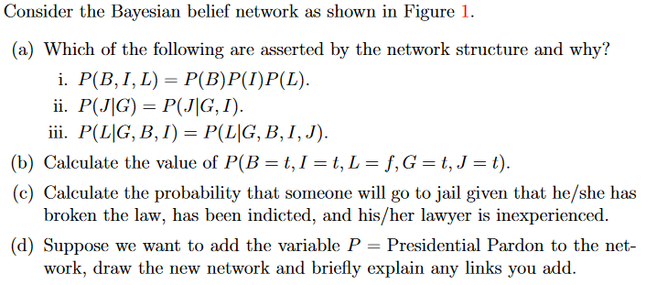
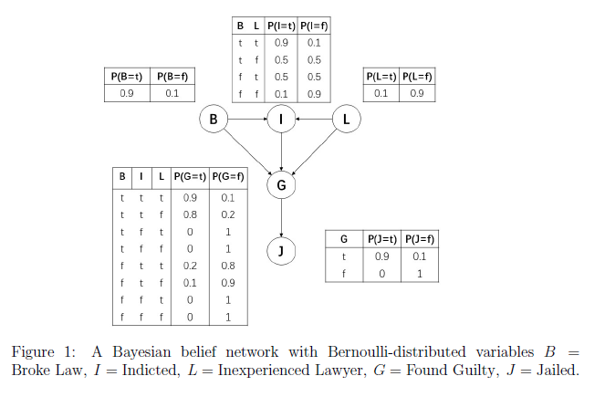
Questions
Question 1
Question 2
Notes:
Here ,the observation x could also be discrete random variable.

